Slide 1
Northern Star Scouting
2023 Popcorn Kickoff
Crunch Kart
Road Rally

Slide 2
Pit
Crew Chief
Bill
Anderson-Horecka
Staff advisor - Northern Star Scouting

Slide 3
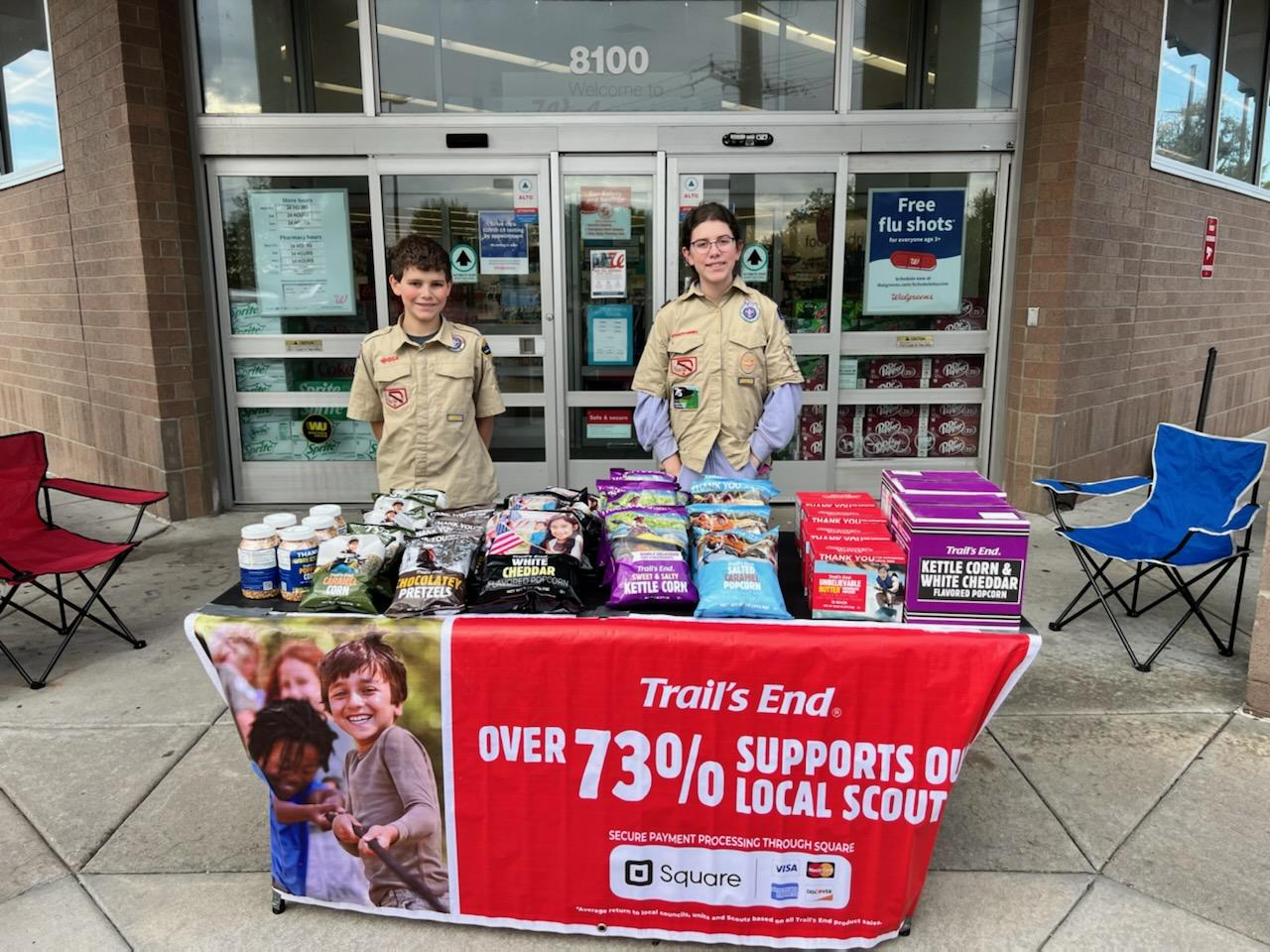
WHY do we sell Popcorn?
73% Return to Scouting
Fund our unit’s Scouting program
Scout character development
Improve our camps and council resources
OVER $1.75 million Returned to Northern Star Scouting in 2022

Slide 4
WHY do we sell Popcorn?
!!!Fund Adventures!!!
Examples:
Campouts
Blue & Gold Celebration
Pinewood Derby
High Adventures
Equipment needs
Advancement
Annual dues
Scouts Learn:
The value of hard work
How to earn their own way
Public speaking
Salesmanship and people skills
Setting and achieving goals
Money management
Scouts Earn Rewards
Amazon e-gift cards
Millions of rewards to choose from
Exclusive COUNCIL prizes!

Slide 5
Your Unit Earns
Commission Type: | Commission Percentage:
ONLINE DIRECT* | 35%
TRADITIONAL/WAGON/TAKE ORDER | 32%
Training Bonus | 3%
Cash Option (Troops and Crews) | 4%
*No rewards opt-out available.
Notes:
Opt-Out commissions generally provided 3% of benefit to the Scout, whereas Trail’s End Rewards provides an average of over 5%, and up to 20% benefit to the Scout!

Slide 6
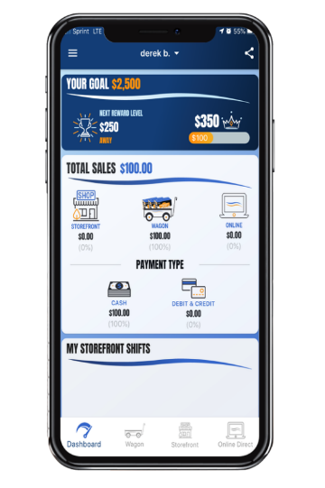
Trail’s End App
Key Benefits
Free Credit Card Processing - Paid by Trail's End
Real-time tracking and reporting of sales, inventory and storefront registrations
Families can turn in cash payments via credit card
System-calculated Scout sales for easy Trail's End Rewards ordering
Advancements that can be earned are now in the app!
Proven Results
Used by over 14,500 units & 160,000 Scouts
Credit Card transactions averaged 27% higher than cash
Text APP to 62771 to download the App.
Text APPGUIDE to 62771 to download the App Quick Start Guide.

Slide 7
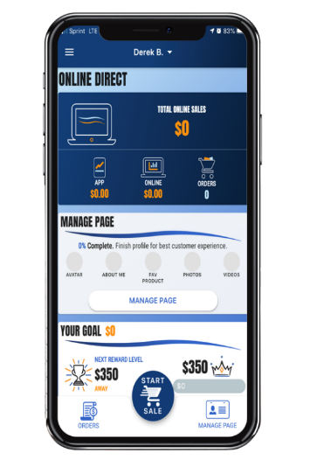
Trail’s End Improvements
App Improvements​​​
Faster, more intuitive Scout registration​
Faster checkout (From 9 to 4 clicks)​
List, grid and product detail views​
Record online orders directly in app​​
Sharable online cart so customer can enter shipping address and complete payment – great for social distancing!
New undelivered logic for Wagon Sales so Scouts enter them correctly​
Credit payment option for parents to pay cash owed to unit​
Improved Trail’s End Rewards​​ focused on reaching next level and goal​
Unit Leader Portal​​ Improvements​
Onscreen guides to help leaders learn Unit Leader Portal features
Consolidated Scout table view to quickly manage orders, inventory, and storefront shifts
Robust products table to easily view inventory at storefronts and with Scouts​
Ability to convert orders between Wagon to Storefront
Ability to change the shift credited to a storefront order

Slide 8
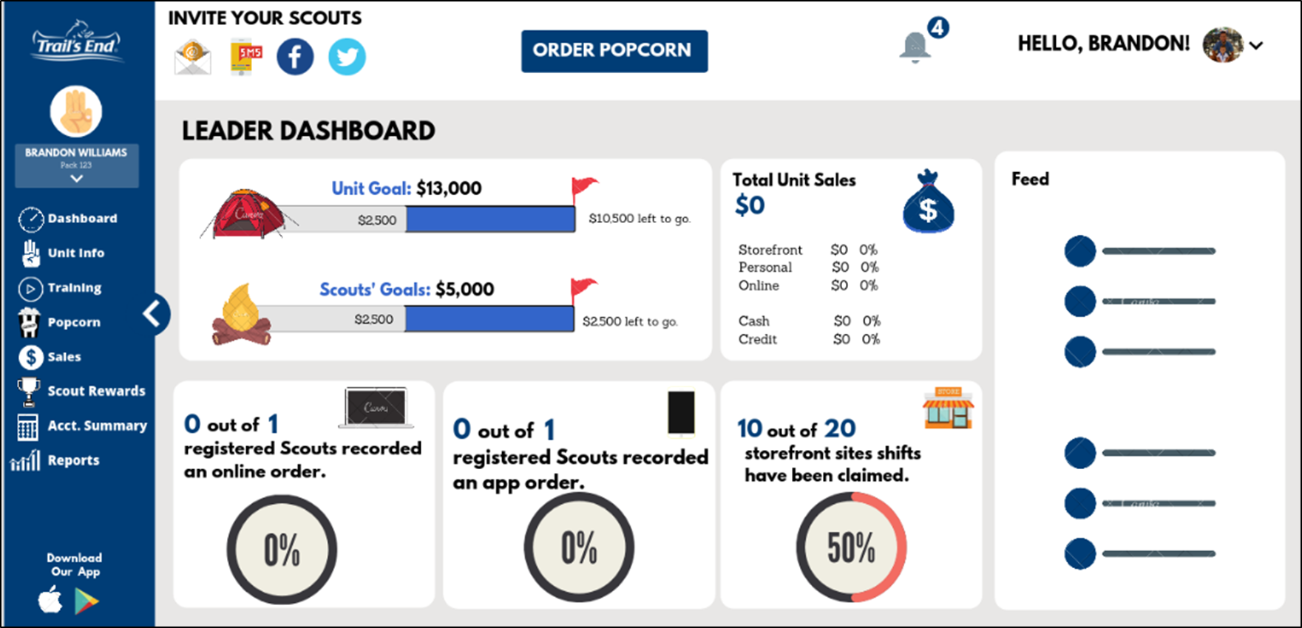
Trail’s End Leader Portal
One Platform to Manage Your Fundraiser
Manage all things sale-related
Mobile-friendly portal via your phone’s browser
When Scouts use the app, Leaders can:
Track progress toward goals
Monitor inventory
Oversee storefront sign-ups
Set up Storefront events
Split sales
Manage accounting and more!
Login at:
www.trails-end.com/leader with your Trail’s End Leader account.

Slide 9
A Successful Sale
Unit Leader Preparation
Attend Webinars & Training Tab
Plan your program year & key adventures
Set budget and goals via the Unit Leader Planner
If participating in Trail’s End Storefront program, reserve prime hours at prime locations
Secure your own additional storefront hours if needed
Obtain supplies:
Square Readers
Storefront supplies
Unit incentives
Review the Unit Leader Portal training tab
Prepare for your Unit Kickoff
Prepare your Scouts & Families
New Scout? Download the app
Text APP to 62771 to download/register
Setup accounts in the app
(One Account per Scout)
Encourage Scouts to review the training tab
Motivate with incentives and how you will use the funds
Communicate key dates and progress

Slide 10
PRODUCTS & ORDERING

Slide 11
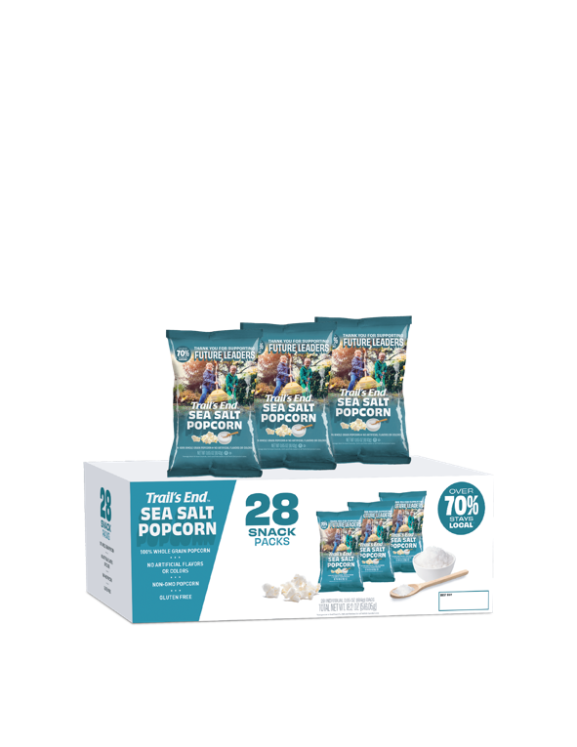
TRAIL’S END 2023
TRADITIONAL PRODUCTS
Sweet and Salty
Kettle Corn
S’mores Popcorn
Popping Corn
White Cheddar Popcorn
$15
$15
$20
$25
Unbelievable
Butter Microwave Popcorn
Salted
Caramel Corn
Chocolatey
Pretzels
Sea Salt
Popcorn
$25
$25
$50
$25

Slide 12
S'mores and Pretzel Ordering info
S'mores will ship at a maximum of 10% (retail) of your orders to stay in line with market research, prevent excess inventory, and manage production constraints.
For every $3,000 ordered, Units can only order 1 case (12 bags) of S’mores. This applies to S’mores only.
Pretzels will be available the week of Sept. 18.

Slide 13
Ways to Sell
ONLINE DIRECT
STOREFRONT SALES
WAGON SALES
Ship direct to your customers
Record in the app
Share your page via email, text, social media or QR code
No handling of products or cash
$65 Average Order
Products & prices may vary
Shipping/Tax may apply
Available year-round
Leverage high foot traffic retailers
Reserved by Unit Leaders
Sign up to sell in person at a store
$162 per hour National average
One parent and one Scout cover more hours
Set your storefront split method in the Leader Portal before storefront sales begin
Deliver product to your family, friends and neighbors' homes
Ask parents to ask their co-workers
Mark sales delivered or undelivered
Delivered: Check out popcorn in advance, and deliver products
Undelivered: Take order and deliver products later
Storefronts!

Slide 14
Ordering Info
SHOW AND DELIVER (WAGON) ORDER DUE Aug 24 at Midnight
Order through the Leader Portal at www.trails-end.com
Up to 90% of what you sold in 2022 (Retail dollars)
Order in full cases only
With the product changes, use your best judgement on what to order based on previous sales and your ordering limit.
We WILL have more product during the sale to check out.
TAKE ORDER DUE SUNDAY NOV 5 AT MIDNIGHT
Order through the Leader Portal at www.trails-end.com
Can order singles
Order your Hometown Heroes credits at take order
NOTEABLE FEATURES
What to order auto populate button
Multifactor Authentication – 30 days
Ordering for two Units

Slide 15
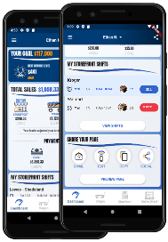
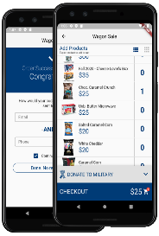
Online Direct
SHARE YOUR PAGE
Share your fundraising page via email, text, or social media.
Customers click your link to place online orders.
Products ship directly to your customer’s home.
DIRECT ORDERS
Pick your products.
Credit or debit payments only
Products ship directly to your customer’s home.

Slide 16
ONLINE ASSORTMENT
www.trails-end.com
$20
$25
$25
NEW
$27
$34
$50
IMPROVED FLAVOR
NEW
NEW
$42
$47
$72
$62
$54
$45
NEW
NEW
Road Trip Variety Pack
Movie Night Bundle
Picnic Bundle
Let’s Go Hiking Bundle
Ultimate Snack Pack
Game Night Bundle
$27
$35
$30
$55
LIMITED TIME OFFERINGS:
Snowflake Pretzels 7 oz $35
Peppermint Bark 9 oz $40
Dark Choc Sea Salt Caramels 10.5 oz $35
Chocolate Lovers Bundle $95
Chocolate Trio Bundle $110
*Products & Pricing are subject to change

Slide 17
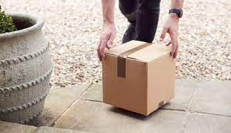
Online Sales - Shipping
Shipping Information
Effective 7/5/2023
$10.99 Paid Freight (vs. $13.99)
$65+ Free Shipping (vs. $70)
+$3.00 Handling
Microwave, Popping, Sea Salt Snack Pack (new)

Slide 18
Unit Booked Storefronts
Best practices when booking your own storefronts:
Determine high foot traffic days, times, and locations (Google Analytics)
Book as far in advance as you can
Visit the store in your Uniform with one or more Scouts
Shop the store, then request to speak with the manager
If permission is granted, ask for and notate expectations and follow the rules
Always say ‘Thank you!”
2 Scouts-2 Adults-2 Hours
2023 Wal-Mart situation

Slide 19
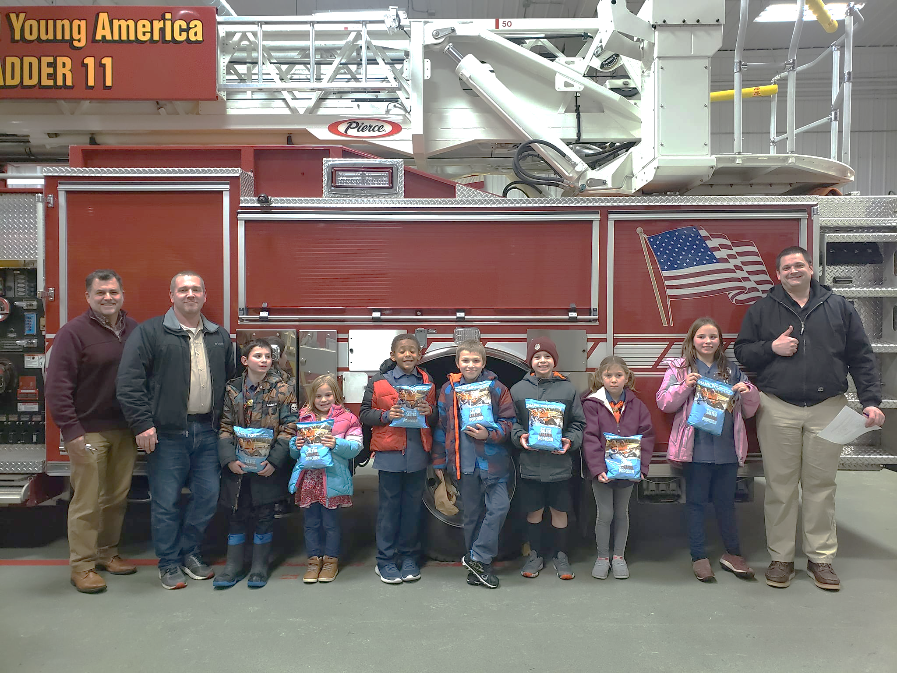
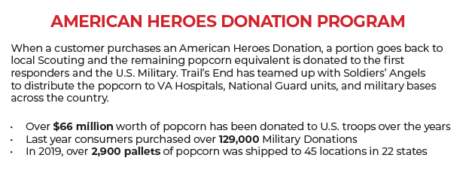
Hometown Heroes
Return product is used to fill our local Hometown Heroes orders.
In 2022, over $95,000 was given to local heroes!

Slide 20
DISTRIBUTION

Slide 21
Distribution
Show and Deliver Pick Ups
Sept 14 or 15
Several Locations Around Council
Reorder Starting Tues Sept 26. Pick up at reorder warehouse or Snack Semi
Home Delivery
Over $15,000 in sales in 2022
Changed to $15,000 in sales in 2022 to qualify for 2023
Must order at least $7,000 or 35% of last year’s sale (whichever is greater)
Need home Delivery Info by Aug 24. We will send out a survey to request the info

Slide 22
Distribution
EARLY RETURNS-
Sunday Oct. 8 and Monday Oct 9 4-7p.m.
No questions asked
Units can only return FULL Cases of product at early return days.
Units will only be able to return up to 15% of their TOTAL Show and Deliver order after Oct 9.
FINAL RETURNS—up to 15% of what physical product you have checked out on Nov 5.
Sunday Nov 5 4p.m.-7p.m.
4 Locations on Sunday
Willmar by appointment.
ABSOLUTELY NO RETURNS AFTER NOVEMBER 5

Slide 23
Transfers
All Transfers are done through the
Trail’s End Leader Portal
You can initiate a transfer
Both parties have to accept
Invoice automatically updates for both Units

Slide 24
Ordering more — Snack Semi/warehouse
During the sale for reorders you can order from the warehouse OR the Snack Semi.
The Snack Semi is similar to the Amazon Treasure Truck.
Order by a certain date each week for pick up around the metro and outlying areas.
Order in full cases
3 days will have stops in 5-7 communities for 30 min before moving on.

Slide 25
ROUTE 2
ROUTE 1
ROUTE 3
ROUTE 4

Slide 26
PRIZES!

Slide 27
Accepting Credit/Debit Cards
CREDIT SALES ARE BEST FOR SCOUTS
TELL YOUR CUSTOMERS,
“WE PREFER CREDIT/DEBIT”
Trail’s End pays for all credit card fees!
Bigger Rewards – Earn 1.25pts per $1 sold in the Trail’s End App
Safer – Scouts and Popcorn Kernels don’t have to handle cash
Higher Sales – Customers spent 29% more with credit vs. cash in 2022
Easier – Parents turn in cash sales with credit/debit payments to their unit
Hardware – Scouts can accept credit/debit with Square readers or manual entry

Slide 28
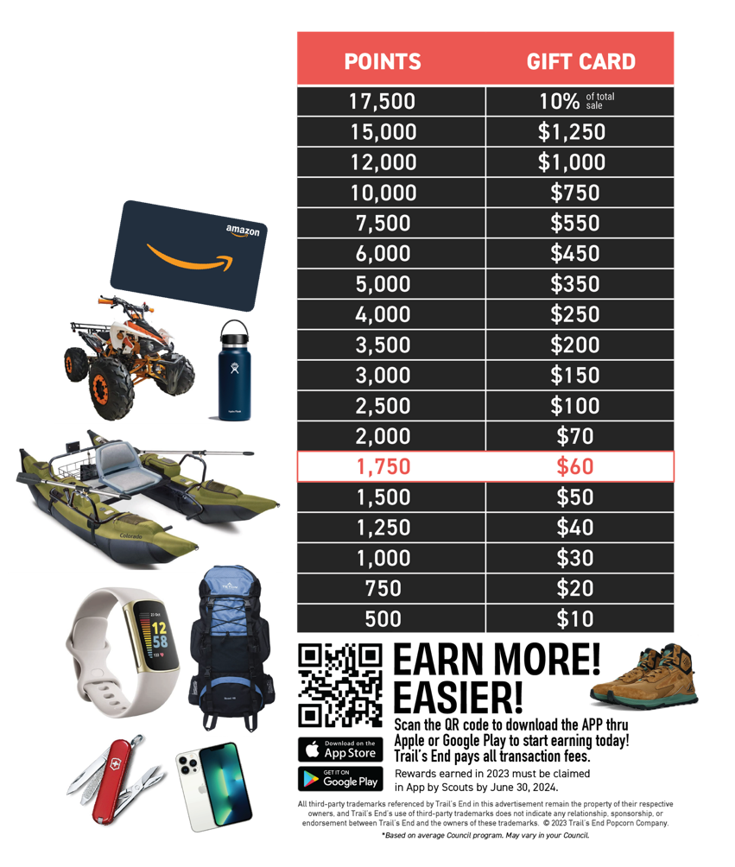
Trail’s End Rewards
Continued in 2023
Points based Rewards system encouraging Scouts to sell more with Online Direct and with credit cards
With changes to the way they sell, Scouts can earn more Rewards faster!

Slide 29
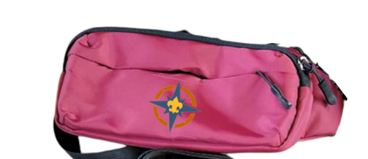
Bonus Prizes—a Northern Star Tradition!
• Bonus Prizes — (All units eligible) Will be at Take Order pick up.
Sell 1 Item— Patch
$850 Club — Northern Star Belt bag and waterproof playing cards
$1250 —Holiday/Circle K road trip pack
$1500—Vikings Family Day
$1900+ — Adventures!
$2500—January 6, 2023 at Base Camp.
Notes:
3 min

Slide 30
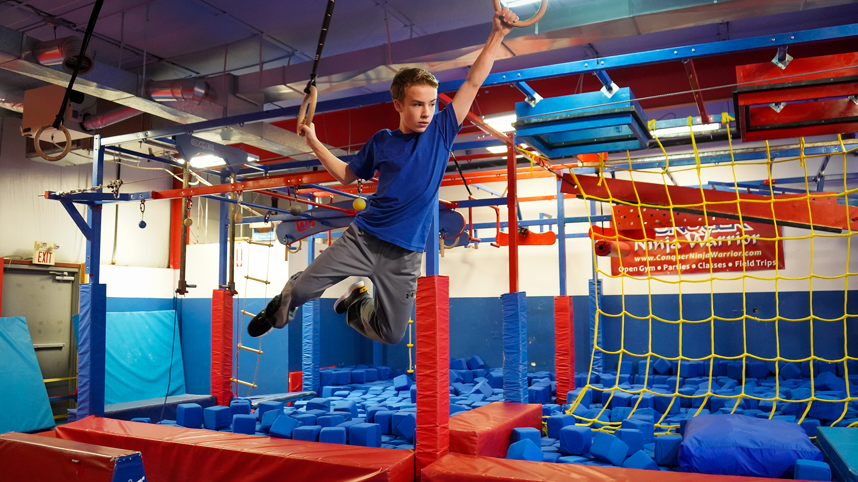
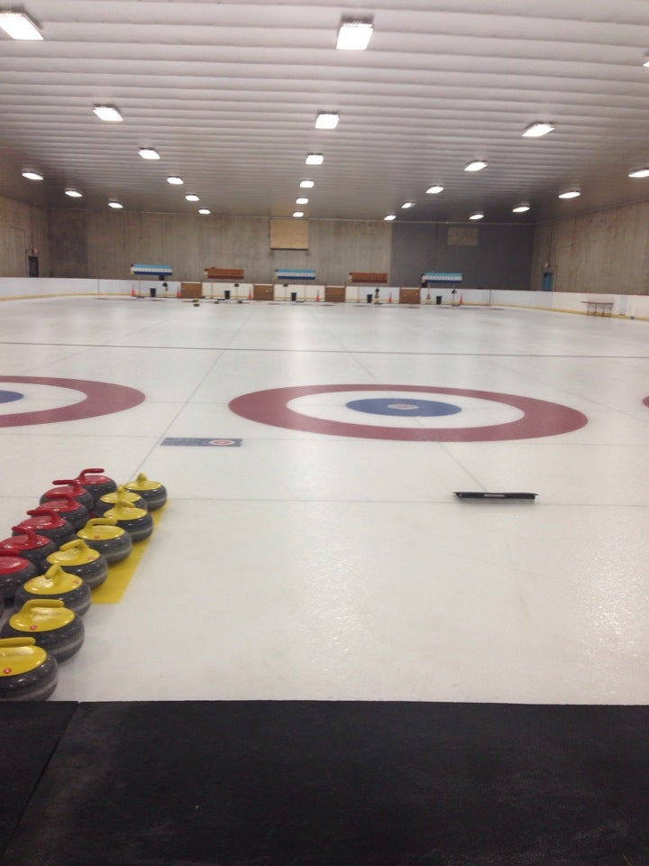
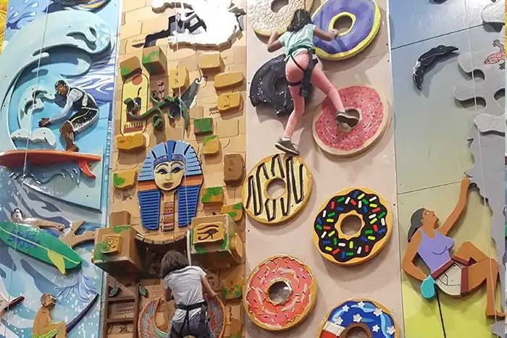
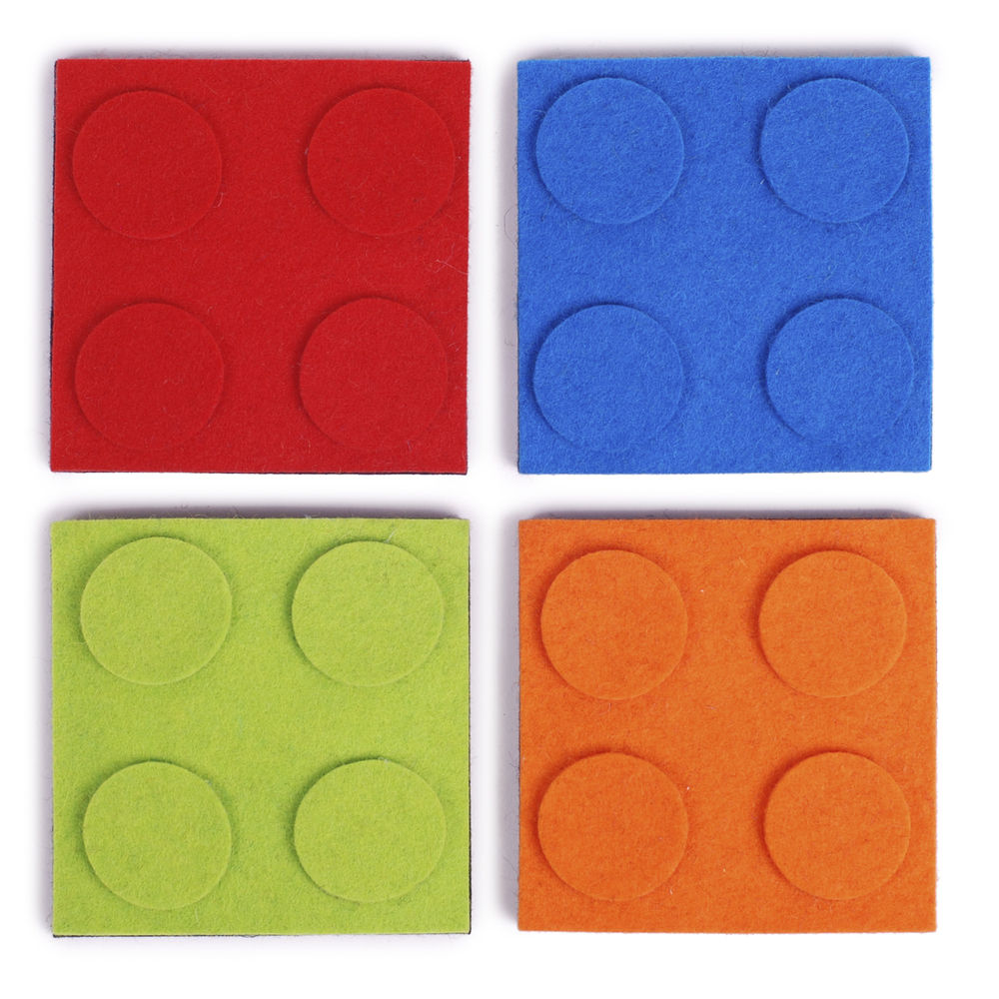
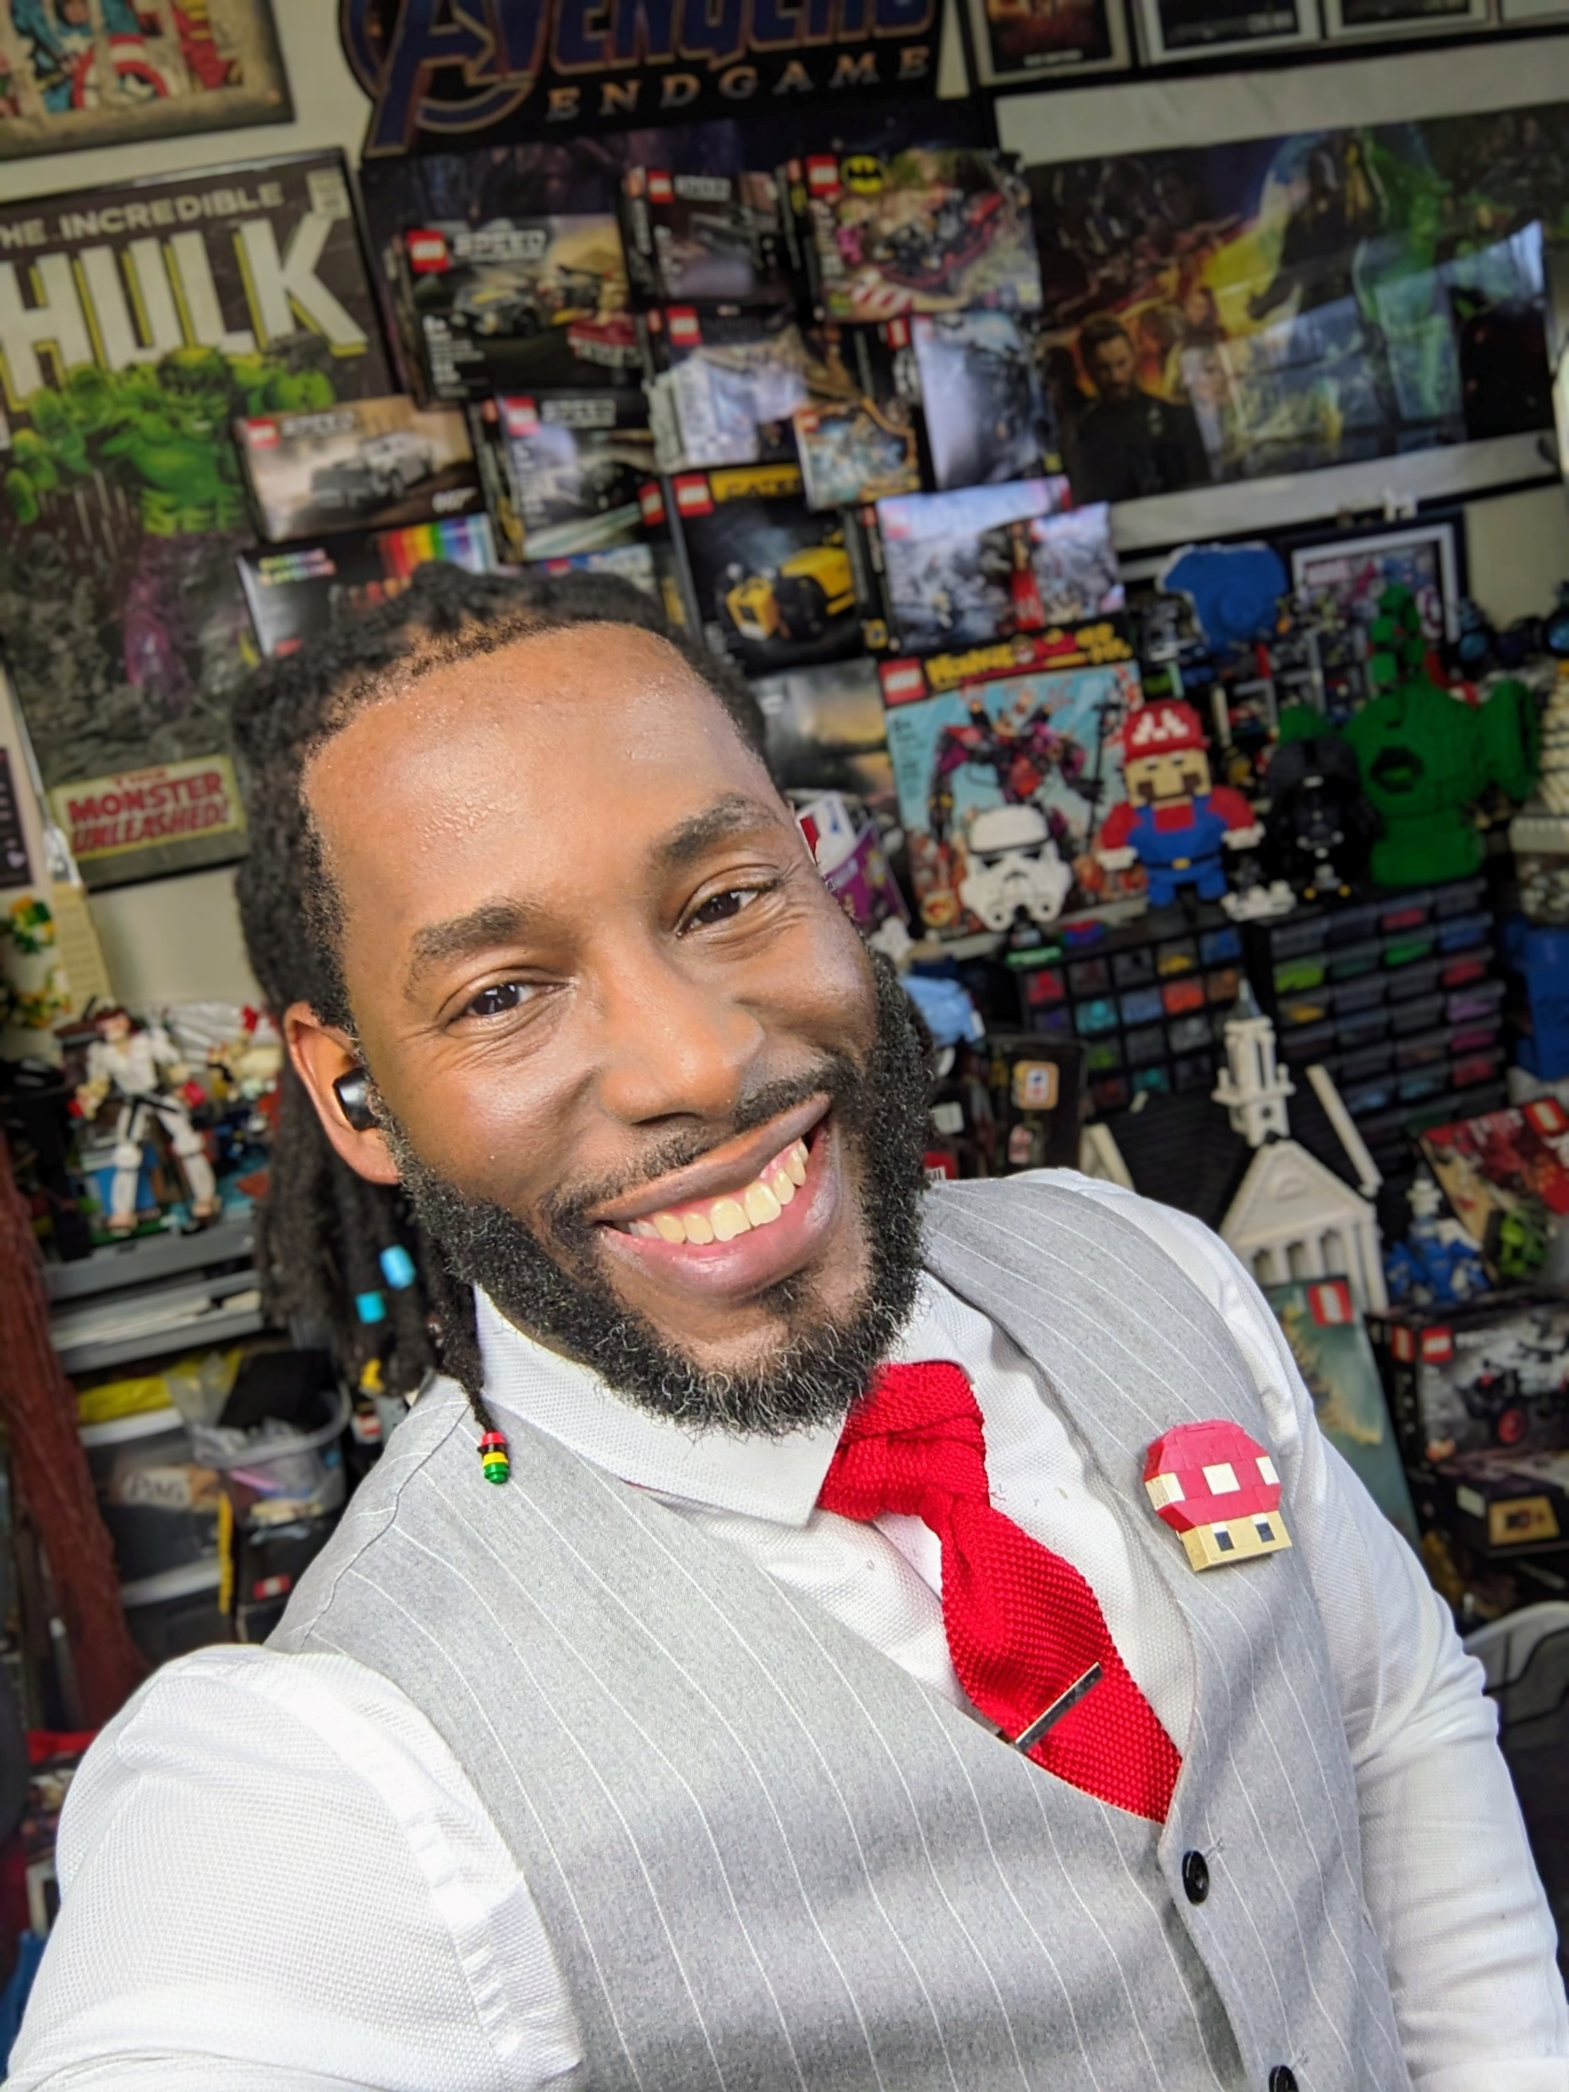
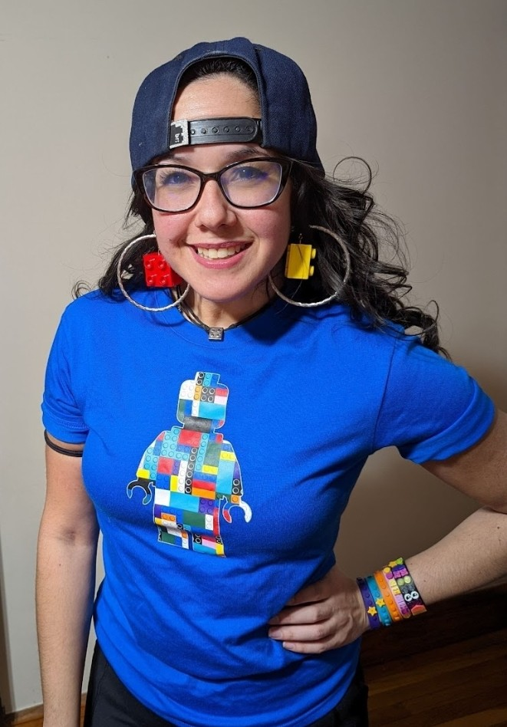
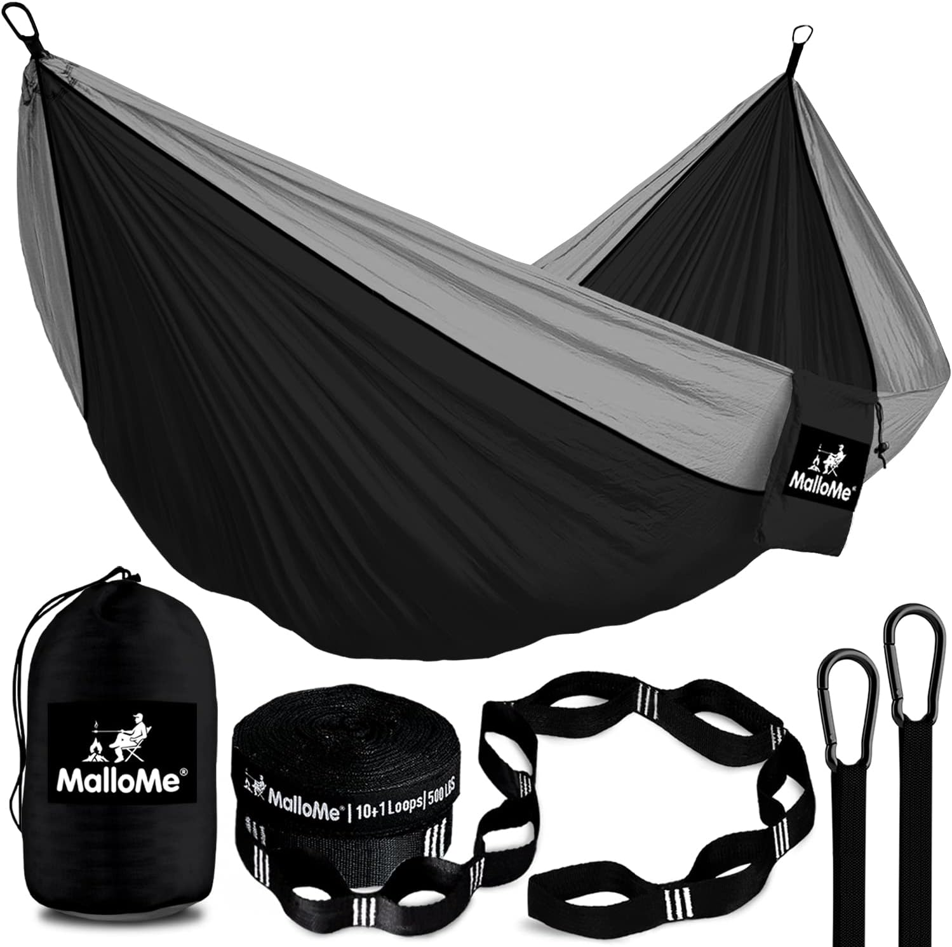
Adventures
Notes:
3 min

Slide 31
Road Rally
Road Rally is for all Scouts selling popcorn. Encourage all of your Scouts to attend!
Base Camp
Date/Time: Open house style on Saturday, Sept. 9, 9:00 a.m. - 1:00 p.m.
Location: Base Camp—6202 Bloomington Road, Fort Snelling, MN 55111.
Stations: (subject to change)
Prize Extravaganza/Bonus Prizes/Adventures
Trail’s End App Practice Your Pitch
Hometown Heroes Storefront Safety
AND MORE!
.
All Scouts who preregister and attend Road Rally get an aluminum logoed water bottle and can earn stickers to put on it and win part of $1500 worth of prizes!
Emails with the sign-up information will be sent out early August to all registered Scouts in the Trails End app, as well as unit chairs. Emails will be sent to popcorn chairs to forward to parents and Scouts.
Notes:
1-2 min

Slide 32
WHAT’S
NEW?

Slide 33
What’s New??
Mystery House Contest—Sponsored by Papa Murphy’s
Each unit will get a certificate to give to a person, who gives it to another person, so the chair doesn’t know who has it.
Scouts go door to door selling.
When a Scout finds a mystery house, they will get a free Large 1 topping Papa Murphy’s Pizza
Scouts then are in a drawing for one of three grand prizes for their unit.

Slide 34
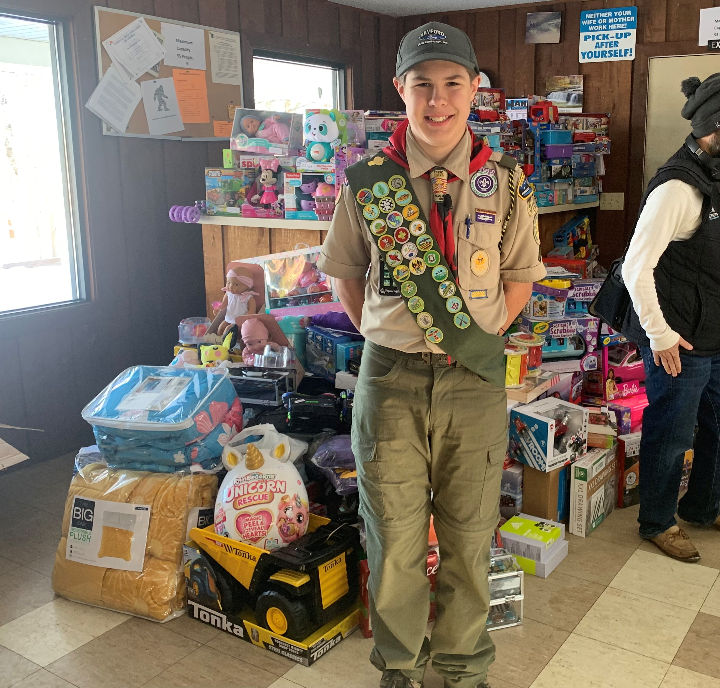
What’s New??
Video Tip Series
Top selling Scouts and Parents
Sales Pitch
How to handle a “no”
Advice for new Scouts
Advice for parents

Slide 35
What’s New??
Set your Goal—get chicken!
Any Scout who enters their goal into the Trail’s End App by Oct. 1 will receive a certificate for a FREE kid’s meal from Raising Cane’s.

Slide 36
What’s New??
Unlock Achievement Stickers!
Scouts can earn up to six water bottle stickers during the sale. Stickers will be handed out at the Take Order pick up and calculated by the Trail’s End app data.

Slide 37
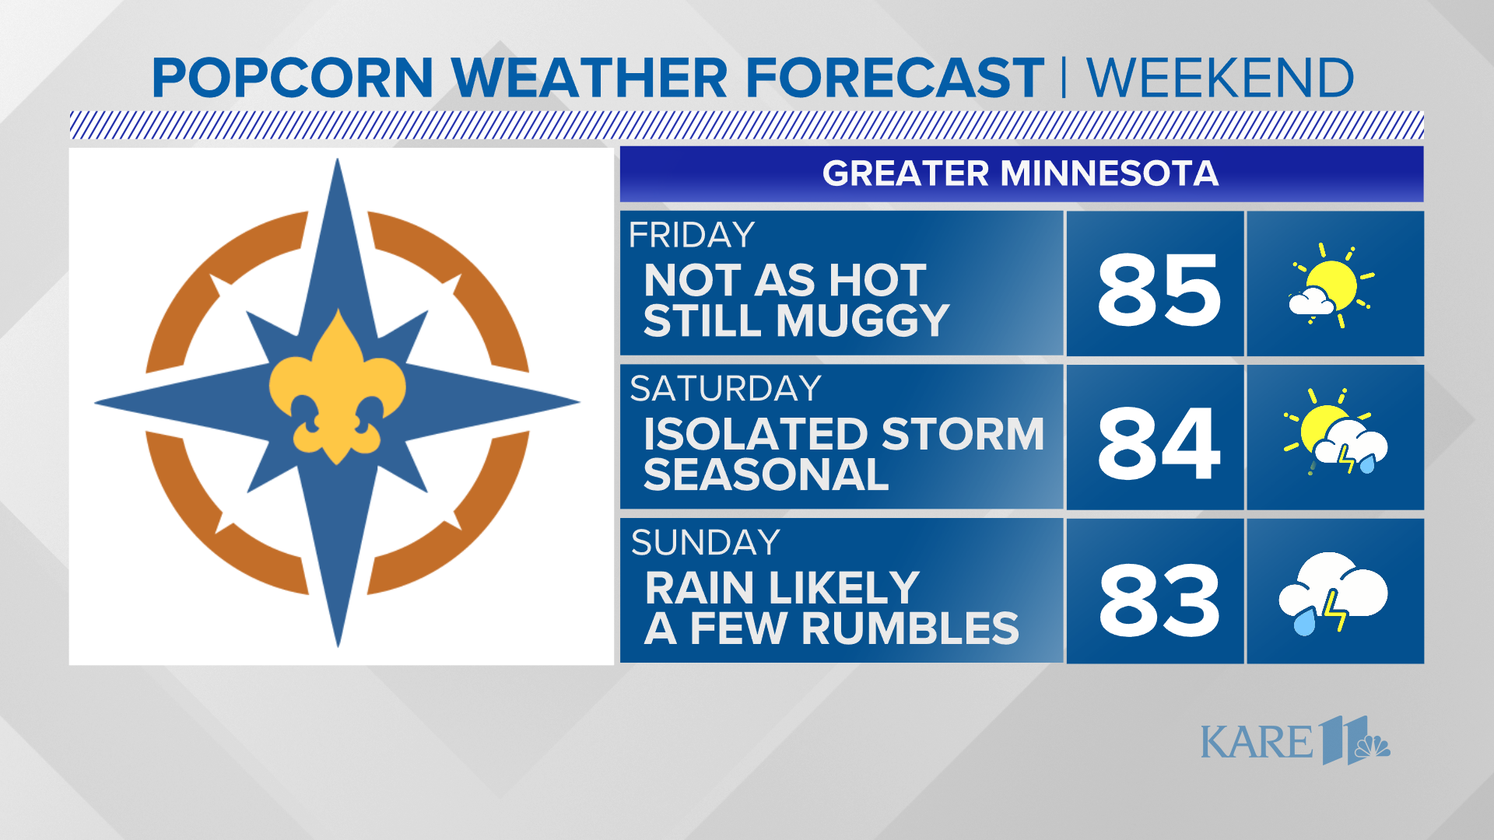
What’s New??
Thursday Popcorn Weather Report
Eagle Scout (Troop 9127, Chisago City) and KARE11 Weatherman Ben Dery is providing a weekend weather report for each weekend of the 2023 sale!
Reports will be emailed out to all Scouts and Chairs on Thursday nights during the sale.

Slide 38
Trail’s End Webinars
Attend Live Moderated Webinars
Register at www.trails-end.com/webinars
New & Existing Unit Kernels are encouraged to attend
Sessions run from July 6 – Sept 9
Training Tab in Unit Leader Portal
Review recorded webinar videos, separated by topic

Slide 39
Trail’s End Facebook
Text FACEBOOK to 62771 to join!

Slide 40
Important Dates
Pre-Sale Prep
Aug. 1-31 Set Unit & Scout Goals. Set Popcorn Kickoff Date for Sept.
Aug. 1-31 Set up Store Front Sale Locations and Blitz Days
Thurs. Aug. 24 Home Delivery Info due 12:00 p.m.
Thurs. Aug. 24 Show & Deliver Order Due at Trails-End.com 11:59 p.m.
Sept. 14-15 District Show and Deliver Pick Up Varies by Area
Sept. 10-21 Home Deliveries Dropped off Varies
Sat. Sept. 9 Road Rally– Council Kickoff—Base Camp 9:00 am.—1:00 p.m.
During the Sale
Fri. Sept. 22 SALE STARTS! 5:00 p.m.
Sun. Oct. 8/Mon. Oct. 9 Early Returns 4:00 p.m.-7:00 p.m.
Sun. Oct. 30 SALE ENDS! 11:59 p.m.
After Sale Wrap Up
Sun. Nov. 5 Final Returns
Sun. Nov. 5 Take Orders Due MIDNIGHT
Nov. 17 Take Order Distribution Varies by area
Nov. 11-17 Take Order Home Deliveries Dropped Off Varies by area
Wed. Dec. 15 Payments Due Tues. Dec. 15

Slide 41
Contacting support
CONTACT TRAIL’S END SUPPORT
JOIN OUR FACEBOOK GROUP
Trail’s End Popcorn Community
VISIT OUR WEBSITE
www.Trails-End.com
EMAIL US:
Support@trails-end.com
NEED HELP? VISIT OUR FAQs:
www.Support.Trails-End.com

Slide 42
What should you do now?
Attend a Trail’s End Webinar
Survey your Scout parents to get a feel if they will sell
Log in to the leader portal at www.trails-end.com
Book storefronts!
Start planning your order
If you don’t have a working login/password, email popcorn@nsbsa.org, make sure to include your Unit and Name.

Slide 43
COUNCIL CONTACT INFO
Bill Anderson Horecka: Staff Advisor
Billa-h@northernstar.org
612-261-2405
Office Support
Becki Whitaker
bwhitaker@northernstar.org
612-261-2403
Thank you!

